Slide 1


Slide 2


Slide 3

Teacher divides class into two groups and have two representatives.
- Teacher prepares a small card with the name of an animal on it and sticks a card to the representative's back and allows them to walk around the group asking different questions to identify who they are.
Only "Yes - No questions" are used for the students to answer "Yes" or "No". The group representative who knows who he/she is first wins.

Slide 4
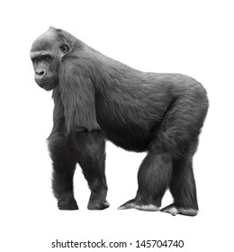

Slide 5
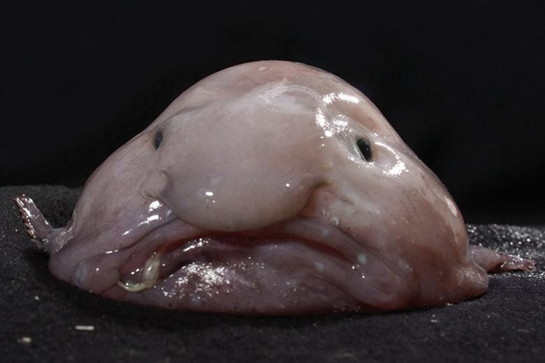
WHICH ANIMALS IS IT?
➔ It is blobfish.

Slide 6

UNIT 3: wildlife
Lesson 2: READING - THE UGLIEST ANIMALS?

Slide 7
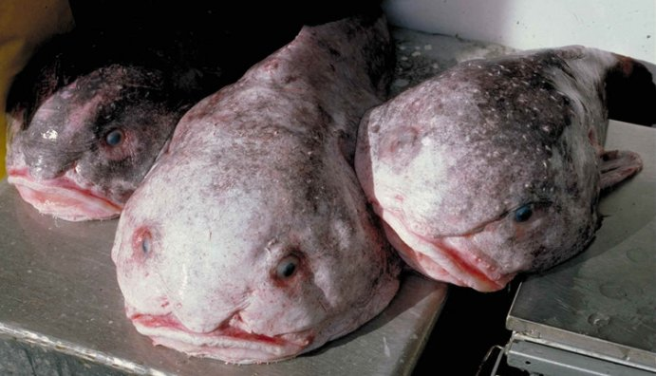
New words
- blobfish (n)
- species (n)
: a group of animals or plants whose members are similar and can breed together to produce young animals or plants
Ex: There are many species of dogs.
- extinct (adj)
: no longer in existence
Ex: The white rhino is now almost extinct.
- weird (adj)
: very strange and unusual, and difficult to understand or explain.
Ex: She's a really weird girl.

Slide 8
New words
- rare (adj)
: not common or frequent; very unusual
Ex: The museum is full of rare and precious treasures.
- danger (n)
: the possibility that someone or something will be harmed , destroyed, or killed
Ex: Animals in danger need our help.
- to protect (v)
: to keep someone or something safe from harm, damage, or illness.
Ex: The best idea is to protect all animals.

Slide 9
Which sentences does the writer agree with?
1) It’s important to protect all animals because they are all interesting.
2) It’s best to protect the beautiful species, not the ugly ones.
3) A lot of species become extinct every year. Animals in danger need our help.

Slide 10

TRUE – FALSE QUIZ
1) The blobfish is quite rare.
T
2) The blobfish
lives 1,000 metres under the sea.
F
sometimes lives in rivers .
T
3) The blobfish is well-known through magazines and the internet.
F
4) There’s a lot of information about pandas, but not whales.
4) We often see information about pandas, whales,….

Slide 11

ANSWER THE QUESTIONS

Slide 12
Where does the blobfish live?
➔ It lives under the seas near Australia.
2) Why is the blobfish famous?
➔ Because people say it is the ugliest animal in the world.
3) How many species become extinct each year?
➔ Thousands of species become extinct each year.

Slide 13

Draw a picture

Slide 14


Do you know the names of any animals in danger?
Do you think which ones are ugly and which ones are beautiful?

Slide 15

Learn new words by heart.
- Prepare the next lesson: LANGUAGE FOCUS.

Slide 16


